Slide 1

www/jspiders.com/placements
BASAVANAGUDI
Welcome to
JSPIDERS BASAVANAGUDI

Slide 2

Duration : 2hrs
Trainer : Mr.Madhu Sundar
Subject : CORE JAVA
Software Development Introduction
BASAVANAGUDI

Slide 3
Software
Software : A software is a group programs which is developed to solve a business problem.
Program : It is a set of instructions which are developed to perform a particular task.
BASAVANAGUDI

Slide 4
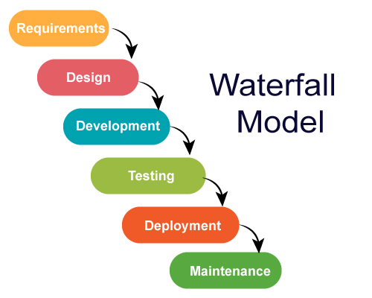
BA(Business Analyst)
Collects the requirements
From the client
BA is expert in the domain
For which the company is planning to develop the software
SDLC
Developers starts coding the application
Based on the LLD given by the Architect
Technical Architect is will design the application based on his experience.
Design is of 2 types
Low Level Design
High Level Design
Test Engineers test the application Manually or using Automation tools against the requirements of the application.
If the application is not working according to requirements the its called a BUG. If bugs are found it should be fixed by developer and s/w will be tested again
A team of Filed Engineers will install the application in Clients Machine or in Servers to start using the application for Real Time Business
A team of Production Engineers will be
24/7 available to keep the S/w running.
Any bugs are found by the Client should
Be fixed by developers.

Slide 5
Types of Software
Standalone Apps
Client/Server Apps
Web Application
Standalone Apps
Any application that runs without any network is called as standalone apps.
Ex : Notepad, Calculator , Calendar etc..
BASAVANAGUDI

Slide 6
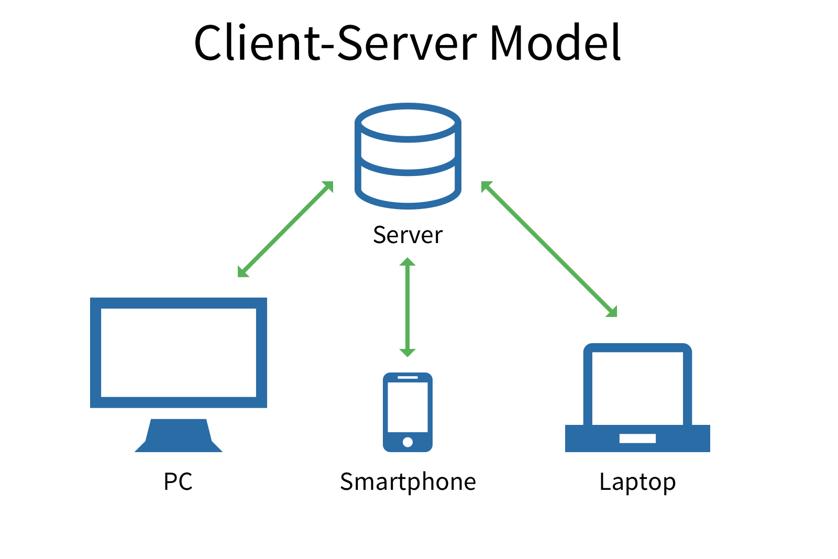
Client/Server Apps
Any application that requires network for its execution is called as client/server apps.
The software developed to access the services of the Server is called as Client.
Client is always installed in user machine( Computer/Mobile Devices)
The software and hardware that receives the request from the client and process it to provide the service is called as Server
Ex : whatsapp, messenger , skype
BASAVANAGUDI

Slide 7
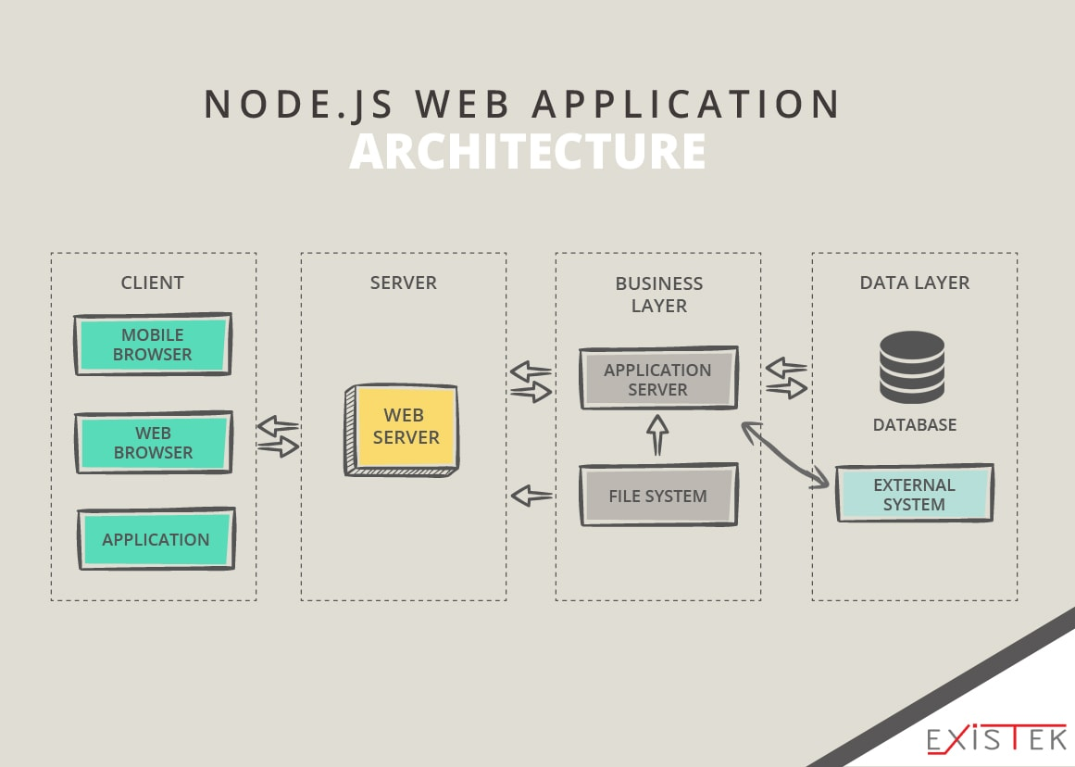
Web-Applications
Any application that requires web browser for its execution is called as web application.
Web App will have 3 layers.
Presentation Layer
Application Layer
Data Layer
BASAVANAGUDI

Slide 8
Web-Applications
Presentation layer consists of web pages which is the front end of web application and it is developed by using HTML,CSS,JS etc..
Application layer consists business logics which process the inputs from front end and provides necessary service by executing the corresponding programs in APP server.
Data layer consists all the business data that is required to run the application such as User details, Account information, Settings data etc.
BASAVANAGUDI

Slide 9
Duration : 2hrs
Trainer : Mr.Madhu Sundar
Subject : CORE JAVA
Program and Programming Language Fundamentals
BASAVANAGUDI

Slide 10
Program
Program : It is a set of instructions which are developed to perform a particular task.
Program Language : It is a language to communicate with a computer from a programmer.
Father of programming lang: Dennis Ritchie(c and unix).
Mother of programming lang: Ada Lovelace(mid-1800).
Father of java programming lang: James Gosling
BASAVANAGUDI

Slide 11

Converts high level language to Assembly level language
low level language or binary language
ON/OFF
Take a
Take b
Store 10,a
Store 10,b
Take c
Add a,b
Store c
Print c
a=10
b=10
c=a+b
Print c
Complier
0 1 0 1 0 1 0 1
Assembler
High level language
C, C++,java ,python ,JS, SQl
Assembly level language
8086 8085
Converts assembly level language to low level language or binary language
BASAVANAGUDI

Slide 12


Birth of Java
Assembly level language created by the assembler can be executed only the same computer which has same OS and CPU in which program was develped and this makes all S/W developed using this language dependent on the platform.
SunMicroSystems a software development company had the vision of developing a programming language which was completely platform independent.
In 1990 a team of Researchers led by James Gosling starts research to develop a platform independent programming language.
In the year 1995 official version of JAVA was first released to the market

Slide 13
JDK(Java Development Kit)
-------
----
-----
-----
---
JVM
Java Virtual Machine
Javac
Java compiler
Bytecode
* Check the syntax of the
program.
if syntax mistake
throw Compile Time Error
else
create convert java code to
bytecode and save it .class
file.
Read a line of code.
Understand a line of code
Execute a line of code
if code is not understandable
throw Run Time Error
or Exception
else
execute the code
Demo.java
Demo.class
Create java program using
Code Editors : Sublime text, Notepad++, Editplus etc..
IDE: NetBeans, Eclipse , IntelliJ , Jcreator
BASAVANAGUDI

Slide 14
Duration : 2hrs
Trainer : Mr.Madhu Sundar
Subject : CORE JAVA
Installation of JDK and Sublime Text
BASAVANAGUDI

Slide 15
Learning objectives
How to set-up JDK for java development.
Learn how to compile and execute java programs
Understanding structure of java program.
BASAVANAGUDI

Slide 16
Trainer : Mr.Madhu Sundar
Subject : CORE JAVA
Chapter 1
Keywords, Identifiers and Variables
BASAVANAGUDI

Slide 17
Keywords
Keywords are those reserved words which will have a pre-defined
meaning defined in the programming language.
Keyword should be written only in lowercase.
https://docs.oracle.com/javase/tutorial/java/nutsandbolts/_keywords.html
BASAVANAGUDI

Slide 18
Identifiers
It is a name given to a package, interface, Class, Methods and Variables.
Identifiers are the names given for an entity in a program.
In java identifiers are used to identify Class, Methods and Variables.
RULES OF IDENTIFIERS.
Identifiers can be alpha-numeric.
Identifiers should not start with numeric .
$ and _ are the only 2 special characters that can be used with Identifiers.
Identifiers can start with $ or _
Single _ is an invalid identifier in java.
Keywords can not be used as identifiers.
BASAVANAGUDI

Slide 19
Variables
A named memory location which is used to store values for the program is called as variable.
To use a variable we have to follow 3 steps
Declaration
Initialization
Utilization
BASAVANAGUDI

Slide 20
Variables
Declaration is a statement which written to specify the type of data to be stored in the given variable.
syntax : datatype varName;
DataType | Capacity | Default value
byte | 8-bits or 1-byte | 0
short | 16-bits or 2-bytes | 0
int | 32-bits or 4-bytes | 0
long | 64-bits or 8-bytes | 0l
float | 32-bits or 4-bytes | 0.0f
double | 64-bits or 8-bytes | 0.0
char | 16-bits or 2-bytes | Space
boolean | 8-bits or 1-byte | false
BASAVANAGUDI

Slide 21
Initialization
Initialization : It is a statement which is written to store the data within a variable using assignment operator(=).
syntax : varName = value;
Utilization
Utilization : It is one or group of statements which is written to use the value in the variable to perform the operation.
syntax : datatype varName = value;
BASAVANAGUDI

Slide 22
Duration : 2hrs
Trainer : Mr.Madhu Sundar
Subject : CORE JAVA
Chapter 2
Operators
BASAVANAGUDI

Slide 23
Operators
Operator performs operations on operands and produce results.
Types of operators
Arithmetic Operators
+ - * / %
Increment and Decrement Operators
++ --
Comparison Operators or Relational Operators
< > == != <= >=
Logical Operators && || ^
Bitwise Operators & | ^
BASAVANAGUDI

Slide 24
Priority | Operator | Operation
1 | () [] -> . :: | Function call, scope, array/member access
2 | ! ~ - + * & sizeof type cast ++ -- | (most) unary operators, sizeof and type casts (right to left)
3 | * / % MOD | Multiplication, division, modulo
4 | + - | Addition and subtraction
5 | << >> | Bitwise shift left and right
6 | < <= > >= | Comparisons: less-than and greater-than
7 | == != | Comparisons: equal and not equal
8 | & | Bitwise AND
9 | ^ | Bitwise exclusive OR (XOR)
10 | | | Bitwise inclusive (normal) OR
11 | && | Logical AND
12 | || | Logical OR
13 | ? : | Conditional expression (ternary)
14 | = += -= *= /= %= &= |= ^= <<= >>= | Assignment operators (right to left)
15 | , | Comma operator
BASAVANAGUDI

Slide 25
Increment Operator
Increment operator will increase the value of a variable by one unit;
Pre-Increment Post-Increment
*increment *substitute
*substitute *operation
*operation *increment
Both Pre-Increment and Post-Increment Operators will show same results if they are used without any expressions or java statements.
Whenever the increment Operator is used with a character variable the unicode value of the character will be increased and its corresponding character will be stored in the given variable.
Boolean variables cant be used with increment operator.
Values cant be directly used with increment operator
BASAVANAGUDI

Slide 26
Comparison Operators
Comparison operators will compare given 2 values and returns a Boolean result
Logical Operators
Logical operators are used to combine multiple Boolean conditions as ONE
single condition.
Logical operators will always return a Boolean result
Different types of logical operators are
Logical AND (&&)
Logical OR(||)
Logical XOR(^)
BASAVANAGUDI

Slide 27
Logical AND &&
Logical AND && operators will return TRUE if and only if the result of both the
Boolean condition’s result is TRUE and in all other cases it returns FALSE
TRUTH table for LOGICAL AND (&&)
CONDITION 1 | CONDITION 2 | RESULT
TRUE | TRUE | TRUE
TRUE | FALSE | FALSE
FALSE | TRUE | FALSE
FALSE | FALSE | FALSE
BASAVANAGUDI

Slide 28
Logical OR ||
Logical OR || operator will return FALSE if and only if the result of both the
Boolean condition’s result is FALSE and in all other cases it returns TRUE
TRUTH table for LOGICAL OR (||)
CONDITION 1 | CONDITION 2 | RESULT
TRUE | TRUE | TRUE
TRUE | FALSE | TRUE
FALSE | TRUE | TRUE
FALSE | FALSE | FALSE
BASAVANAGUDI

Slide 29
Logical XOR ^
Logical XOR ^ operator will return FALSE if and only if the result of both the
Boolean condition’s result is FALSE or TRUE and in all other cases it returns TRUE
TRUTH table for Logical XOR ^
CONDITION 1 | CONDITION 2 | RESULT
TRUE | TRUE | FALSE
TRUE | FALSE | TRUE
FALSE | TRUE | TRUE
FALSE | FALSE | FALSE
BASAVANAGUDI

Slide 30
Bitwise Operator
Bitwise operator will perform bitwise operations on every bit of given value and
produce results as 0 or 1
25
2|12-1
2|6-0
2|3-0
2|1-1
Result : 11001
100
2|50-0
2|25-0
2|12-1
2|6-0
2|3-0
2|1-1
Result : 1100100
0011001
1100100(&)
------------------
0000000
0*2^6+ 0*2^5+ 0*2^4+ 0*2^3+ 0*2^2+ 0*2^1+
0*2^0 =
RESULT : 0
0011001
1100100(|)
------------------
1111101
0011001
1100100(^)
------------------
1111101
BASAVANAGUDI

Slide 31
Concatenation Operator
concatenation oprt(+) : Is used to join a String value with any other data.
Between a string and any other type if you use + oprt it will join the string and given
value creating a new String.
Ex : "hello"+"world“
“hello"+10
BASAVANAGUDI

Slide 32
Trainer : Mr.Madhu Sundar
Subject : CORE JAVA
Chapter 3
Methods/ Functions
BASAVANAGUDI

Slide 33
methods
It is used to execute a sequence of statement.
Methods are used to eliminate duplicate lines of code in the program.
Methods are named blocks of codes which will perform a specific task.
Syntax : access access return name(argument list)
specifier modifiers type
{
stmt..
stmt..
return;
}
Access modifier : static.
Access specifier : public, protected, pkg-level, private.
Return type : depends on the data type of the value returned from the method
BASAVANAGUDI

Slide 34
methods
If methods returns any value then the returned value should be stored in a
variable matching the return type of the method.
A method which is calling another method is known as calling method.
A method which is called by another method is known as called method.
return statement is used to transfer the control and the values from called
method to calling method.
BASAVANAGUDI

Slide 35
methods
If methods do not return any value then its return type should be declared
as void.
If return type of method is void then, programmer can skip writing the
return statement.
BASAVANAGUDI

Slide 36
Trainer : Mr.Madhu Sundar
Subject : CORE JAVA
Chapter 3
FLOW CONTROL STATEMENTS
BASAVANAGUDI

Slide 37
Flow control statements
Flow control statements are used to control the execution flow of the program at
the runtime.
Flow control statements are of 2 types
Decision Making Statements
Looping Statements
BASAVANAGUDI

Slide 38
Decision Making Statements
Decision Making Statements are used to execute one or group of statements based on a Boolean condition.
Boolean cond / Boolean exp : a Comparison statement written using Comparison
opts and logical opts is called Boolean exp/cond.
Types of Decision making statements are
IF
If-else
if-else-if
Switch-case

Slide 39
if - statement
it is a type of decision making where one or group of statements written within the if body will be executed if and only if result of Boolean condition
is true .
Syntax : if(Boolean cond)
{
stmt..
stmt.
}

Slide 40
if - else statement
It is a type of decision making statements where statements of if body are executed if result of boolean condition is TRUE else the statements of else body are executed .
Syntax : if(Boolean cond)
{
stmt..
stmt.
}
else
{
stmt
stmt
}

Slide 41
if – else - if statement
It is a type of decision making statements which is used to whenever there are multiple Boolean conditions to be evaluated to execute different set of statements.
Syntax : if(Boolean cond1)
{
stmt..
stmt.
}
else if(Boolean cond2)
{
stmt
stmt
}
else
{
stmt
stmt
}

Slide 42
switch case - statement
It is a type of decision making statements which is used whenever there are only equals conditions to be evaluated to execute different set of statements.
Syntax : switch(choice)
{
case choice 1 : stmts
break;
case choice 2 : stmts
break
default : stmts
}

Slide 43
Looping Statements
Looping Statements are used to execute one or multiple Statements repeatedly.
In java there are 4 looping statements
For loop
While loop
do-while loop
for-each loop
BASAVANAGUDI

Slide 44
Looping Statements
class Email
{
sendmail(int num)
{
loop(num) num = no. of To email ids
{
—-
——
}
}
}
To : xyz@gmail.com
pqr@gmail.com
Subject : ————-
———————————
msg
Send
BASAVANAGUDI

Slide 45
For loop
for-loop is used whenever logical start and logical end is very well defined.
syntax :
start check did you reach the end
for(intialization; stop_condition; counter)
{
stmts..
stmts...
}
BASAVANAGUDI

Slide 46
Trainer : Mr.Madhu Sundar
Subject : CORE JAVA
Chapter 3
ARRAYS
BASAVANAGUDI

Slide 47
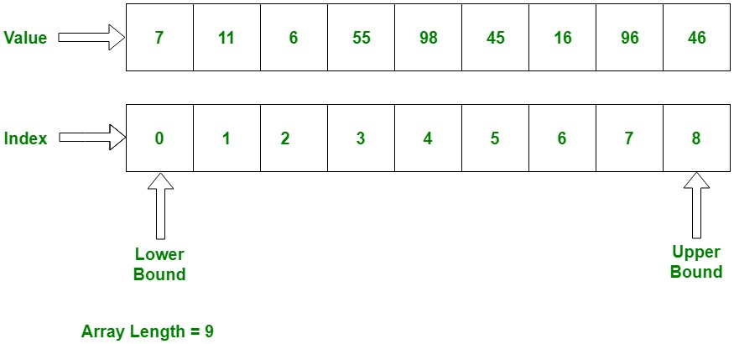
Arrays
Array is a group of same type of data which has a fixed length and index to identify every bucket uniquely.
0 1 2 3 4 5 6 7 8
Upper Bound
Lower Bound
Array Length = 9
BASAVANAGUDI

Slide 48
Arrays
Array Decleration
syntax : datatype[] arrayVarName;
ex : int[] arr;
syntax : datatype arrayVarName[];
ex : int arr[];
[] -> subscript
Array Creation
syntax : arrayVarName = new datatype[size];
ex : arr = new int[10];
BASAVANAGUDI

Slide 49
Arrays
Array Decleration and Creation
syntax : datatype[] arrayVarName = new datatype[size];
ex : int[] arr = new int[10];
Once the array is created all the buckets will be filled with default values depending on the data type of the array.
length is an in-built variable which contains the count of no. of buckets in the given array.
Array Decleration and Creation
syntax : datatype[] arrayVarName = {v1,v2,v3...};
ex : int[] arr = {20,40,12};
BASAVANAGUDI

Slide 50
Arrays
first index -> 0 (lower bound)
last index -> arr.length - 1 = 9-1 = 8 (upper bound)
mid index -> (arr.length-1)/2 = (9-1)/2 = 4(middle bound)
BASAVANAGUDI

Slide 51
Trainer : Mr.Madhu Sundar
Subject : CORE JAVA
Chapter 3
Strings
BASAVANAGUDI

Slide 52
Strings
String value is a group of characters which is written in the double quotes.
A String in Java is actually an object, which contain methods that can perform certain operations on strings.
We can access the characters or perform any operations on the string only by
using the methods of String.
Internally String value is stored as a character Array by the JVM.
‘h’ | ‘e’ | ‘l’ | ‘l’ | ‘o’
0 | 1 | 2 | 3 | 4
String str = “hello”
BASAVANAGUDI

Slide 53
Methods of String
length() : It returns the count of number of characters present in the given String.
charAt(index) : It returns the character at the given index from the given String.
indexOf(char) : It returns the index of the given character from the given String. It returns -ve value if the character do not exist.
indexOf(char,startIndex) : It returns the index of the given character
from the given String by starting the search from the given startIndex.
equals(string) : It compares characters of given two strings and returns
true if they are exactly same else it returns false.
BASAVANAGUDI

Slide 54
Methods of String
equalsIgnoreCase(string) : It compares characters of given two strings by
igiorning the case and returns true if they are exactly same else it returns false.
substring(start, end-1) : It creates a String from the given start index and given end-1 index no. of characters and returns the String.
NOTE
length and length()
length -> variable used in array
length() -> method of String
BASAVANAGUDI

Slide 55
Duration : 2hrs
Trainer : Mr.Madhu sundar
Subject : CORE JAVA
Section :OOPS
Object Oriented Programming System
BASAVANAGUDI

Slide 56
Section 2 Object Oriented Programming Syllabus
- Classes and Objects
- Object creation
- Reference variable
- Global and local variables
- Constructors
- Composition
- Inheritance *****
- Method Overloading
- Method Overriding
- Abstract classes
- Interfaces
- Typecasting
- Polymorphism
Abstraction
Java packages
Access Specifiers
Encapsulation

Slide 57
Duration : 2hrs
Trainer : Mr.Madhu sundar
Subject : CORE JAVA
Section :OOPS
CLASSES
and
Objects
BASAVANAGUDI

Slide 58
Class
Class is blueprint of an object.
A class will have 2 types of members
Data members
Function members
Data members are those variables which are declared within the body of the class.
Function members are those methods/functions which are declared within the body of the class.
Members of the class are of 2 types
static
non-static
BASAVANAGUDI

Slide 59
object
An object is an instance of a class. it is mainly used to allocate memory of a class member & member Function
These are also referred to as Non-primitive .
applications
Objects are required in OOPs because they can be created to call a non-static function.

Slide 60
Static Members
Any data member or function member of the class declared by using static keyword is called as STATIC MEMBER.
Present in different class
Static member present in different class can be accessed by using class name
with member name.
Ex : ClassName.memberName
Present in same class
Static member present in same class can be accessed just by using mebername.
BASAVANAGUDI

Slide 61
Non-Static Members
Any data member or function member of the class declared by without using static keyword is called as NON-STATIC MEMBER.
Present in different class
Non-Static member present in a different class can be accessed within any method of a different class only by creating the object of the class.
BASAVANAGUDI

Slide 62
Object creation
Object of a class can be created by using following syntax :
new ClassName();
Creates a new object
in the memory of
the given class
and returns its
address
Constructor Call or class name
Copy all the non-static
members of the class to
the new object created
BASAVANAGUDI

Slide 63
Present in same class
Non-Static member present in a class can be accessed within a static method only by creating the object of the class.
Non-Static member present in a class can be accessed within a non-static method directly by using membername.

Slide 64
ACCESSING MEMBERS
ACCESS MODIFIER LOCATION | STATIC | NON-STATIC
SAME CLASS | Just by using the member name | Static method : only by creating the object of the class. Non-Static method : Just by using the member name.
DIFFERENT CLASS | Using classname with the member name. ClassName.membername | only by creating the object of the class
BASAVANAGUDI

Slide 65
Static Members
Static members will have only one copy in the memory.
If the value of a data member in a class is not changing from object other object
then those data members should be declared as static.
If a function member / method in a class is using only static members of the class
then those function member / method should be declared as static.
BASAVANAGUDI

Slide 66
NON-STATIC MEMBERS
Non-Static members will have multiple copy in the memory.
If the value of a data member in a class is changing from object other object
then those data members should be declared as non-static.
If a function member / method in a class is using at least one non-static members of the class then those function member / method should be declared as non-static.
BASAVANAGUDI

Slide 67
Reference Variables
It is a type of variable which is used to store address of an object.
Within a reference variables we can’t store primitive values.
Within a primitive variables we can’t store store address of an object.
Within one reference variables we can store ONLY ONE OBJECT ADDRESS.
Multiple reference variables can point to same object.
If Multiple reference variables points to same object then, changes done on the data of the object by one reference variable will impact other reference variables.
If two reference variables points to different objects then, changes done on the data of one object by one reference variable will NOT impact other reference variables.

Slide 68
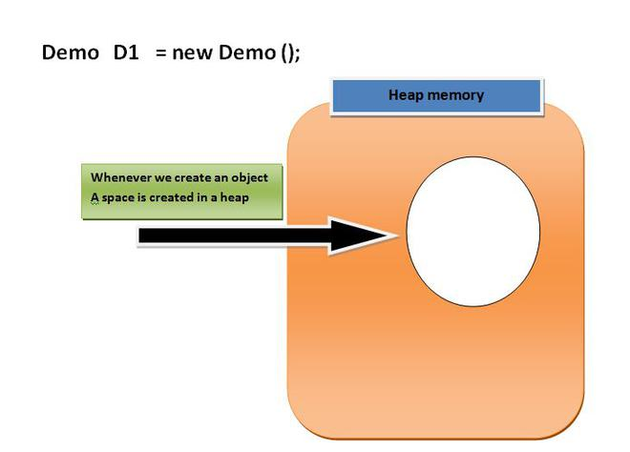
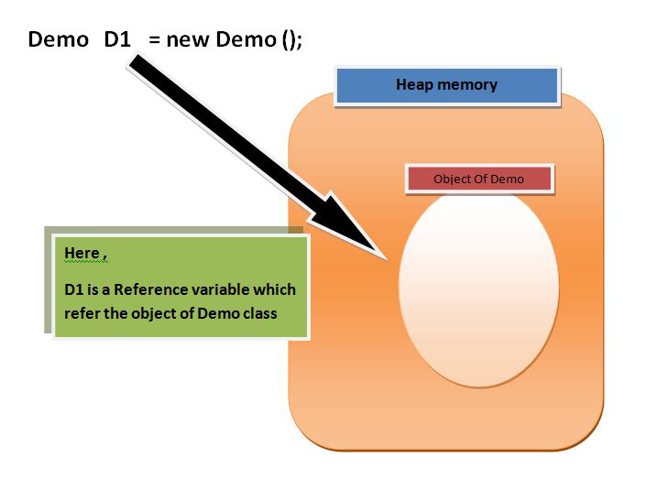
Class, interface, arrays, enumeration are reference types in java.
When we create an object (instance) of class then space is reserved in heap memory.
Demo D1 = new Demo();
Then how to access heap memory ?
The heap memory is the area of memory used to store objects.
Just by creating a reference variable.it will point object in heap memory.

Slide 69
Trainer : Mr.Madhu sundar
Subject : CORE JAVA
Chapter 2
Global variables and Local variables
BASAVANAGUDI

Slide 70
Global variables
Any variable which is declared within the body of the class is called Global variable.
Global variables can be accessed by any method present in same class.
Global variables will be initialized by the compiler with the default values if the programmer do not initialize them.
Global variables are nothing but DATA MEMEBERS of the class.
Local variables
Any variable which is declared with the method declaration and within the method definition is called as local variable.
Local variables can be accessed only by the method in which it is declared.
Local variables should be initialized by the programmer with the values explicitly.
BASAVANAGUDI

Slide 71
Trainer : Mr.Madhu sundar
Subject : CORE JAVA
Chapter 3
Constructors
BASAVANAGUDI

Slide 72
Constructors
Constructors are special type of methods which have same name as the class name..
Constructors are executed whenever the object of that corresponding class is created.
Every class must and should have Constructor.
If the programmer do not write any constructor, then compiler will write default constructor implicitly.
If the programmer writes constructor it can be of two type
1. Zero argument constructor
2. Parameterized constructor
Constructors cannot be declared as static or final.
If you specify return type for the constructor, then it will be considered as a normal method.
If the programmer writes any constructor explicitly, then complier will not write any constructor implicitly.
App.
Constructors are used to Intialize the data members of the class.
BASAVANAGUDI

Slide 73
Constructors cannot be declared as static or final why?
Static: because as we know that constructor will be executed whenever the object is created object is created for non static not for static so.
Final: because final method cannot be overridden by any of the sub class or it cannot be inherited.
Why constructor cannot be inherited: because subclass has a different name.
If we inherit constructor we cannot achieve encapsulation.
class book{
public book(){
System.out.println("done");
}
}
class pen extends book{
public book(){
System.out.println("finish");
}
}
class notes {
public static void main(String[] args) {
book b1=new book();
pen p=new pen();
}
}

Slide 74
Constructors
This keyword
this keyword is used to differentiate between local variables and Global variables within a method / constructor whenever they have same names.
BASAVANAGUDI

Slide 75
f
Trainer : Mr.Madhu sundar
Subject : CORE JAVA
Chapter 4
Relations between classes or Objects
BASAVANAGUDI

Slide 76
Class diagrams
A Class diagram is pictorial representation of class.
Class diagrams helps understanding the relations between classes in much better way.
2 classes are related based on the dependency of class object over the another class object.
2 classes are related based by two types relations
1. Has-A relation
2. Is-A relation(inheritance)
Has-A relation
Has-A relation is a type of relation where 2 classes are related based on the dependency of existence of one class object over the another class object.
Has-A relation is implemented by creating GLOBAL STATIC REFERENCE variable pointing to the object of another class.
BASAVANAGUDI

Slide 77
f
Trainer : Mr.Madhu sundar
Subject : CORE JAVA
Chapter 5
Inheritance
BASAVANAGUDI

Slide 78
Inheritance
One class acquiring the properties of another class is called is inheritance.
The class from where properties are inherited is called as superclass or base class or parent class.
The class which is inheriting properties is called as sub class or derived class or child class.
In java inheritance is achieved by using extends keyword.
Using superclass object we can access ONLY properties of superclass
Using subclass object we can access properties of both subclass and superclass
final classes CANNOT be inherited.
final data members and function members of the class can be inherited.
constructors of the class CANNOT be inherited.
private data members and function members of the class CANNOT be inherited.
Using subclass object we can access both static and non-static properties of both subclass and superclass
BASAVANAGUDI

Slide 79
final classes CANNOT be inherited why ?
the main purpose of class being declared as final is because to prevent the class from being subclassed
Why constructor cannot be inherited ?
because subclass has a different name.
If we inherit constructor we cannot achieve encapsulation.
class book{
public book(){
System.out.println("done");
}
}
class pen extends book{
public book(){
System.out.println("finish");
}
}
class notes {
public static void main(String[] args) {
book b1=new book();
pen p=new pen();
}
}

Slide 80
Inheritance
Different types of inheritance are
1. Single inheritance
2. Multilevel inheritance
3. Multiple inheritance
4. Hierarchical inheritance
5. Hybrid inheritance
BASAVANAGUDI

Slide 81
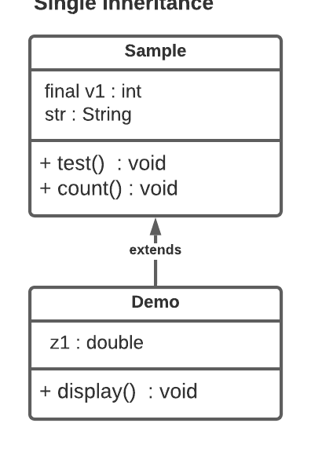
Single inheritance
one Subclass inheriting from one Single Superclass is called as Single Inheritance.
BASAVANAGUDI

Slide 82
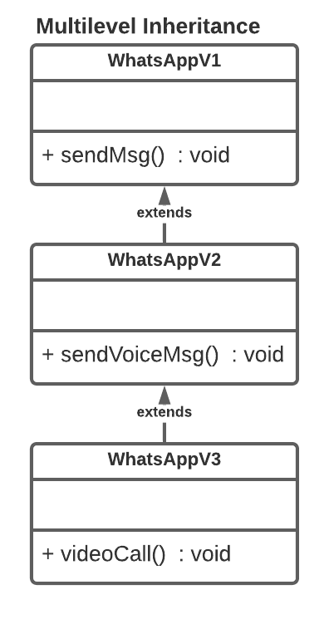
Multilevel Inheritance
Subclass inheriting the properties of superclass and that superclass inheriting the properties from another superclass is called as Multilevel inheritance.
BASAVANAGUDI

Slide 83
Multiple inheritance
Subclass inheriting the properties from 2 or more superclass is called as Multiple inheritance.
Java don't support Multiple inheritance.
BASAVANAGUDI

Slide 84
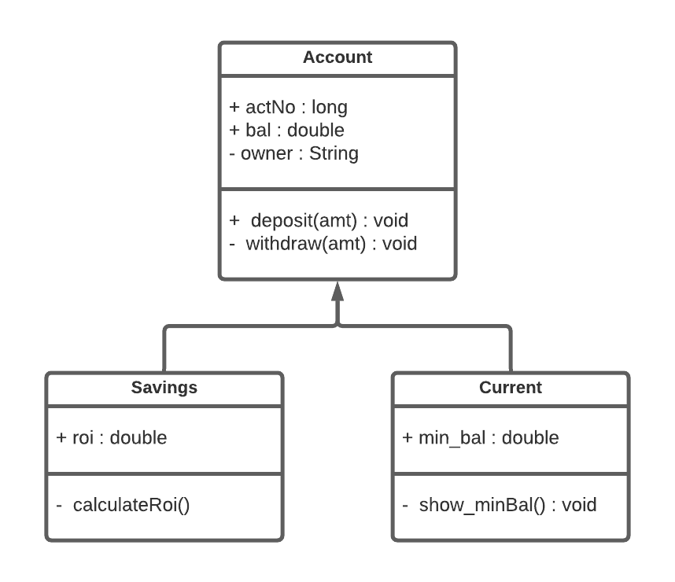
Hierarchical inheritance
One superclass inherited/extended by two or more subclasses is called as Hierarchical inheritance.
BASAVANAGUDI

Slide 85
Generalization
Declaring same methods and variables in all sub class to one superclass.
BASAVANAGUDI

Slide 86
Specialization
Declaring specific methods and variables in sub class.
BASAVANAGUDI

Slide 87
Hybrid Inheritance
It is the combination of Different types inheritance.
BASAVANAGUDI

Slide 88
super statement
super(); (super statement)
super(); creates the object of superclass whenever object of subclass is created to inherit the properties.
super(); can be written explicitly by the programmer or implicitly by the compiler at the compile time.
If the superclass contains only parameterized constructors then the programmer should write super(); explicitly and pass the required arguments.
super(); must be written ONLY within the constructor body.
Always superclass object should be created first and then properties should inherited to subclass object and hence super(); should be always written at the first line of constructor body.
Multiple super(); within the same constructor body is NOT allowed. because writing Multiple super(); may lead to creation of multiple superclass objects which is not required.
BASAVANAGUDI

Slide 89
Inheritance
Object class is the super Most class in java.
Each and every class directly or indirectly inherits from object class .
Why java do not support Multiple Inheritance?**OR Explain Diamond problem in java? (this is the problem raise in multiple inheritance )
It creates an ambiguity/confusion for the complier to choose the path from which superclass the properties of object class should be copied to subclass.
To call multiple Constructors of multiple Super classes we should write multiple super(); which is not supported in java.
If both super classes have methods with same name and same arguments, then it creates an ambiguity for the complier to choose which method should be called for the execution when it called using subclass object.
Constructor chaining :
It is the process of subclass constructor calling its superclass constructor and superclass constructor calling object class constructor.
BASAVANAGUDI

Slide 90
f
Trainer : Mr.Madhu sundar
Subject : CORE JAVA
Chapter 6
Method Overloading
BASAVANAGUDI

Slide 91
Method Overloading
Developing multiple methods within the same class with the same name which may differ in
1. Number of arguments
2. Data type of arguments
3. Order of arguments
is called as Method Overloading.
Ex: println() is the best example for Method Overloading.
Advantage: It is easy to remember One method which may perform similar operation with different arguments.
Disadvantage: If proper documentation are not maintained for every overloaded method it will be difficult for the new developer to understand behavior of every method.
BASAVANAGUDI

Slide 92
f
Trainer : Mr.Madhu sundar
Subject : CORE JAVA
Chapter 6
Constructor Overloading
BASAVANAGUDI

Slide 93
Constructor Overloading
Developing multiple constructors within the same class with the same name which differ in
1. No. of arguments or
2. data type of arguments or
3. order of arguments
is constructor overloading
BASAVANAGUDI

Slide 94
f
Trainer : Mr.Madhu sundar
Subject : CORE JAVA
Chapter 7
Method Overriding
BASAVANAGUDI

Slide 95
Method Overriding
Subclass inheriting method of superclass and changing the method definition according subclass specification without changing method declaration is called as method Overriding.
Inheritance is mandatory for method Overriding.
@ -> annotation
@Override (Override annotation) it compares the given method declaration of subclass with every other method declaration present in superclass and throws an error if there is no matching declaration found.
Final, Private and Static methods cannot be Overridden.
If Subclass and Superclass contains STATIC methods with same name and same arguments then it is called as Method Hiding.
super keyword
super keyword is special in-built reference variable which is crated by JVM and it will point to immediate Parent class object.
super keyword is used within the subclass methods in order to access properties of its immediate superclass.
BASAVANAGUDI

Slide 96
f
Trainer : Mr.Madhu sundar
Subject : CORE JAVA
Chapter 8
Abstract class and Abstract methods
BASAVANAGUDI

Slide 97
Abstract
incomplete
A method which has only method declaration and no method definition is called as Abstract method.
Abstract method must be declared by using abstract keyword.
If a class contains at least one abstract method, then the class must be declared as abstract class.
It is impossible to create object of an Abstract class.
We can create reference variables of abstract class type.
A method which has both method declaration and method definition is called as concrete method.
If a class contains only concrete methods, then the class is called as concrete class.
If a class inherits from an abstract class then the subclass must override all the abstract methods present in super class else the class must be declared as abstract(incomplete).
BASAVANAGUDI

Slide 98
Abstract
abstract methods cannot be declared as
final
static
private
within an abstract class we can write
1. only abstract methods or
2. only concrete methods or
3. both abstract and concrete methods
Non-static non-private members of abstract class can be accessed by creating the object of its subclass only.
Static non-private members of abstract class can be accessed by using the class name.
If Generalized methods of all the subclasses have same definitions then those methods should declared as concrete methods in Generalized class.
If Generalized methods of all the subclasses have different definitions then those methods should declared as abstract methods in Generalized class.
BASAVANAGUDI

Slide 99
Abstract
Application of Abstract class:
By using abstract classes we can ensure there are no missing method implementations the subclass.
Abstract acts a blueprint to create concrete class.
final class cannot be inherited
- final methods can be inherited but cannot be overridden
- final variables can be inherited but cannot be re-intialized
BASAVANAGUDI

Slide 100
f
Trainer : Mr.Madhu sundar
Subject : CORE JAVA
Chapter: 9
Interface
BASAVANAGUDI

Slide 101
Interface
Interface is a type where methods are by default abstract and variables are by default static and final.
It is impossible to create object of an interface.
We can create reference variables of interface type.
The class can inherit the properties of an Interface only by using Implements keyword.
The interface from where properties are inherited is called as Super Interface
The class which is implements the interface is called as Implementation Class
If a class implements an interface then the implementation class must override all the abstract methods present in super Interface else the class must be declared as abstract class.
An interface cannot implements another interface.
An interface should only extends another interface.
An interface can NEVER inherit or extends from a class not even from Object class
BASAVANAGUDI

Slide 102
Interface
A class can implements any number of interfaces.
A class can extends and implements at the same time.
A class can extends ONLY one Superclass but it can implements any number of interfaces at the same time.
Application
If we have to develop a class using Two Super Types then we should use interfaces.
Note: Abstract class cannot be used here because, a class cannot extends from Two Different super classes at the same time.
From JDK 8 interfaces now on supports concrete methods.
concrete methods of interface should be declared only by using 2 keywords
1. static - for static methods
2. default - for non-static methods
if you want a concrete method within the interface which should NOT be overridden in implementation class then method shall be declared as static method.
BASAVANAGUDI

Slide 103
Application
It is used to achieve total abstraction.
Since java does not support multiple inheritance in case of class, but by using interface it can achieve multiple inheritance .
Interfaces are used to implement abstraction.
From JDK 8 interfaces now on supports concrete methods.

Slide 104
Interface
if you want a concrete method within the interface which you want to be overridden in implementation classes then method shall be declared as default method.
static methods of interface can be accessed by using interface name with dot(.) operator.
default methods of interface can be accessed by using Object of its implementation class ONLY.
If two interfaces contains static methods with the same name and same arguments then , we differentiate them with help of Interface Name.
If two interfaces contains default methods with the same name and same arguments then , it should be overridden in the implementation class.
BASAVANAGUDI

Slide 105
f
Trainer : Mr.Madhu sundar
Subject : CORE JAVA
Chapter: 10
TypeCasting
BASAVANAGUDI

Slide 106
TypeCasting
Converting one Type to another Type is called is TypeCasting.
TypeCasting is of 2 types
Primitive Casting
Derived Casting
Converting one Primitive data type value to another Primitive data type value is called as Primitive Casting.
Primitive Casting is of 2 types
Widening
Narrowing
Widening : Converting lower data type value to Higher Data type value
Widening is done implicitly by the compiler.
Narrowing : Converting higher data type value to lower Data type value.
Narrowing should be done explicitly by the programmer by writting
casting statement.
Syntax : (datatype) val/var;
BASAVANAGUDI

Slide 107
TypeCasting
If a method is having Primitive data type argument then for the same method we can pass values which are lower data type compared to given method argument
If there are 2 overloaded methods one with lower data type argument and other with higher data type argument, if you pass a lower data type value and call the method , compiler will always choose method with lower data type argument
Even though int and float have same capacity the data is represented in a different format.
Compared to float and int , float is higher data type and int is lower data type
Even though long and double have same capacity the data is represented in a different format.
Compared to double and long , double is higher data type and long is lower data type.
If you store a character value within an integer variable then its unicode value will be stored in the given integer variable.
BASAVANAGUDI

Slide 108
TypeCasting
Converting one object reference type to another object reference type is called as Derived casting.
Derived casting is of 2 types
1. Upcasting
2. Downcasting
Converting subclass object reference to superclass object reference is called Upcasting
Upcasting is achieved by storing the address of subclass object into superclass reference variable
Any superclass reference variable pointing to subclass object is called as Upcasted reference.
Using an Upcasted reference we can access only properties of superclass in the subclass object and it is impossible to access subclass properties.
Converting Upcasted object reference back to subclass object reference is called Downcasting.
Using an Downcasted reference we can access properties of superclass and subclass.
BASAVANAGUDI

Slide 109
TypeCasting
NOTE : INHERITANCE IS MANDATORY FOR DERIVED CASTING
what is ClassCastException?
Whenever we try downcast an upcasted reference to a different class reference which do not contains the properties of given object, then jvm will throw ClassCastException
If a method is having Superclass reference argument then for the same method we can pass all of its Subclass references compared to given method argument
If there are 2 overloaded methods one with Super class reference argument and other with Subclass reference argument, if you pass Subclass reference and call the method , compiler
will always choose method with Subclass reference argument
instanceof operator compares given object reference with the given class returns true if it contains the given class properties else it returns false..
*** If you want to access Parent class properties which is common to all Sub-class then, there is no need of performing any downcasting.
BASAVANAGUDI

Slide 110
f
Trainer : Mr.Madhu sundar
Subject : CORE JAVA
Chapter: 11
Polymorphism
BASAVANAGUDI

Slide 111
Polymorphism
One entity showing different behaviors at different places is called Polymorphism
Polymorphism is of two types
1. Compile time Polymorphism
2. Runtime Polymorphism
Compile Time Polymorphism
Binding the method declaration to method definition by the compiler at the compile time based on the arguments is called as compile time Polymorphism.
Since the binding is done before the execution it is called as early binding.
Once the binding is done it cannot be changed at the Runtime and hence it is also called as Static Binding
Method Overloading is the best example for Compile time Polymorphism
BASAVANAGUDI

Slide 112
Run Time Polymorphism
Binding the method declaration to method definition by the JVM at the run time based on the objects is called as run time Polymorphism
Since the binding is done during the execution it is called as late binding
Once the binding is done it can be changed at the Runtime and hence it is also called as dynamic Binding.
Method Overriding is the best example for Run time Polymorphism
Golden java rule
***** Using an upcasted reference if you call an overriden method then you always get the implementation of subclass.
BASAVANAGUDI

Slide 113
f
Trainer : Mr.Madhu sundar
Subject : CORE JAVA
Chapter: 12
Abstraction
BASAVANAGUDI

Slide 114
Abstraction
Abstraction - Hiding
Abstract - incomplete
Hiding the implementation details of a class and exposing only the services or behaviours is called Abstraction
Abstraction is achieved by creating 3 layers
- Object Implementation layer
- Object creation layer
- Object utilization layer
Generalize all the subclass methods and declare them as abstract methods in a common Super Class or Super Interface and create Object Implementation layer
Create Object creation layer by Creating a class that will create the objects of implementation class and upcast it to Super Class or Super Interface reference.
Within the Object utilization layer utilize upcasted reference returned by Object creation layer to call the Generalized methods.
BASAVANAGUDI

Slide 115
Abstraction
By using Abstraction we can achieve loose coupling where changes done in object implementation layer will not have any impact on object utilization layer
BASAVANAGUDI

Slide 116
f
Trainer : Mr.Madhu sundar
Subject : CORE JAVA
Chapter: 13
Java Packages
BASAVANAGUDI

Slide 117
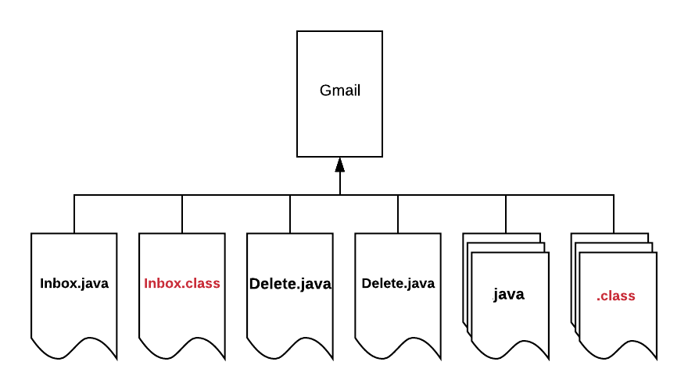
Packages
Managing Source code is difficult
Creates Naming collisions
Security for classes and its members is not guaranteed
BASAVANAGUDI

Slide 118
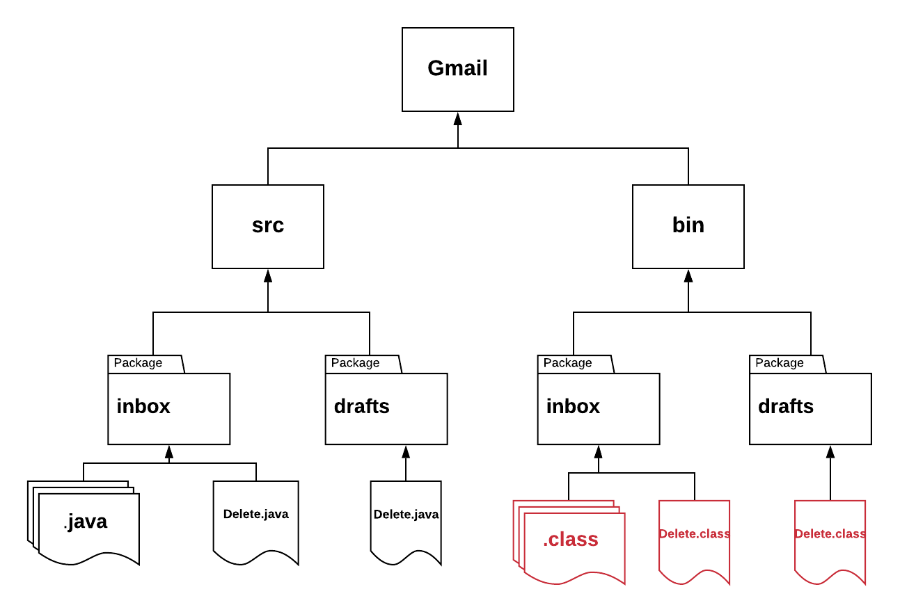
Packages
BASAVANAGUDI

Slide 119
Packages
A java package is group of classes and interfaces which are related to one single module in the given project.
Package naming convention
package name is always written in all-lowercase.
package names are always written in reverse order of domain
convention 1
domain.appname.modulename
com.gmail.inbox
convention 2
domain.companyname.appname.modulename
com.google.gmail.inbox
BASAVANAGUDI

Slide 120
Packages
Data members and function members of a class present in different package can be accessed by two ways
Using fully qualified class names
Using import statement
A class name which is written with its package name is called as fully qualified class name.
BASAVANAGUDI

Slide 121
f
Trainer : Mr.Madhu sundar
Subject : CORE JAVA
Chapter: 14
Access Specifier
BASAVANAGUDI

Slide 122
Access Specifier
Access specifiers are used to provide security for the classes and its members by controlling the visibility.
Public
Protected
Security
visibility
Pkg-level
Visibility
security
Private
BASAVANAGUDI

Slide 123
Access Specifier
public :
if you declare any entity as public, then it can be accessed by the classes present in same or different package.
public entities will have highest visibility and lowest security.
protected :
If you declare any entity as protected, then it can be accessed by the classes present in same package.
protected entity can be accessed by other class present in different package through inheritance and creating the object of SUBCLASS ONLY.
pkg-level(default) :
if you declare any entity without using any access specifier keyword then it is considered as pkg-level member(default member).
if you declare any entity as pkg-level(default), then it can be STRCITLY accessed ONLY by the classes present in SAME package.
private :
if you declare any entity as private, then it can be accesses ONLY by the class within which they are declared.
private entities will have highest security and lowest visibility.
BASAVANAGUDI

Slide 124
f
Trainer : Mr.Madhu sundar
Subject : CORE JAVA
Chapter: 15
Encapsulation
BASAVANAGUDI

Slide 125
Encapsulation
Declaring data members as private and grant the access through getter and setter methods is called encapsulation
getter method returns the current value of the data member
return type of getter method depends on the data type of the data member who's value will be returned
setter method updates the value of the data member.
return type of setter method will be usually void because it doesn't return any value.
Encapsulation is used to provide security for data members against the invalid values.
BASAVANAGUDI

Slide 126
f
Trainer : Mr.Madhu sundar
Subject : CORE JAVA
Chapter: 15
SECTION 3
BASAVANAGUDI

Slide 127
f
Trainer : Mr.Madhu sundar
Subject : CORE JAVA
Chapter: 15
Java Libraries
BASAVANAGUDI

Slide 128
Java Libraries
* java.lang
It contains all the classes which are essential to write simple
java program or to develop complicated java applications.
* To use classes of java.lang package we need not write any import statement of fully qualified class names.
Object class
* Object is super-most class in java
* Each and every class directly or indirectly inherits from object class
docs : https://docs.oracle.com/javase/8/docs/api/java/lang/Object.html
BASAVANAGUDI

Slide 129
Java Libraries
* methods of Object class
-hashCode()
-toString()
-equals()
-wait()
-wait(long)
-wait(long,int) } --> Threads
-notify()
-notifyAll()
-clone() --> Object cloning
-getClass()
-finalize() --> Garbage collection
BASAVANAGUDI

Slide 130
Java Libraries
hashCode()
* Returns a hash code value for the object.
* hash code value of an object is an unique integer value which is generated
by the jvm based on the address of the given object.
toString()
* Returns string representation of the Object
* String representation contains
*Fully qualified class name
*@ character
*hexadecimal value of hashCode
equals(anotherobject)
* it compares the hashcode value of given 2 objects and returns true
if they are same else it returns false.
BASAVANAGUDI

Slide 131
Trainer : Mr.Madhu Sundar
Subject : CORE JAVA
Strings Class
BASAVANAGUDI

Slide 132
Strings
String value is a group of characters which is written in the double quotes.
We can access the characters or perform any operations on the string only by
using the methods of String.
Internally String value is stored as a character Array by the JVM.
String str = “hello”
‘h’ | ‘e’ | ‘l’ | ‘l’ | ‘o’
0 | 1 | 2 | 3 | 4
BASAVANAGUDI

Slide 133
Methods of String
length() : It returns the count of number of characters present in the given String.
charAt(index) : It returns the character at the given index from the given String.
indexOf(char) : It returns the index of the given character from the given String. It returns -ve value if the character do not exist.
indexOf(char,startIndex) : It returns the index of the given character
from the given String by starting the search from the given startIndex.
equals(string) : It compares characters of given two strings and returns
true if they are exactly same else it returns false.
BASAVANAGUDI

Slide 134
Methods of String
equalsIgnoreCase(string) : It compares characters of given two strings by
igiorning the case and returns true if they are exactly same else it returns false.
substring(start, no.of chras) : It creates a String from the given start index with given no. of characters and returns the String.
NOTE
length and length()
length -> variable used in array
length() -> method of String
BASAVANAGUDI

Slide 135
String Class
String value is group of chars written within double quotes
* In java String is a class which is used to store group of
chars the String object.
* String class is immediate sub-class of Object class
* String class implements Serializable, Comparable<String>, CharSequence interfaces
String class is final and it cannot be inherited.
hashCode() of Object class is overriden in String class which returns an integer value that is generated based on unicode values of every character present in given String
BASAVANAGUDI

Slide 136
String Class
* toString() of Object class is overriden in String class
which returns the string value present in given string
object.
* equals() of Object class is overriden in String class
which compares characters present in given 2 strings
and returns true if they are same else returns false
* String objects are created in special memory area called string pool in heap areaa
* The String pool consist of two parts
1.Constant pool
2.Non-constant pool
BASAVANAGUDI

Slide 137
String Class
* String objects can be created in 2 diff ways
1. By using new operator
2. Without using new operator
* If you create a String object without using new operator then the object will be
created in Constant pool.
* If you create a String object by using new operator then the object will be
created in non-constant pool.
Note : == operator compares address of given two Objects.
* Within constant pool duplicates are not allowed.
* Within non-constant pool duplicates are allowed.
BASAVANAGUDI

Slide 138
String Class
* If you create any string object in following format then the resultant string object
will be created in non-constant pool.
"" + Svar
Svar + ""
Svar + Svar
String class is immutable. Explain **** or Why String objects are immutable
If you try to re-intialize a string object then, a new object will be created with the new value
& the reference variable starts pointing to new object leaving old object de-referenced.
BASAVANAGUDI

Slide 139
String Class
Advantage : If 2 ref. variables are pointing same string object
then changes done on the object through one reference
variable will not effect another reference variable.
Disadvantage : If you reintialize same reference variable for n number
of times then it will result in creation of multiple
de-referenced objects which will occupy the memory space
and may lead to OutofMemoryError.
To overcome the disadvantage of immutable property java developers
created two new classes
1. StringBuffer
2. StringBuilder
BASAVANAGUDI

Slide 140
Trainer : Mr.Madhu Sundar
Subject : CORE JAVA
StringBuffer and StringBuilder Classes
BASAVANAGUDI

Slide 141
StringBuffer Class
java.lang.Stringbuffer
* write a function to return the first half of the given string
* StrinBuffer is mutable sequence of characters.
* A string buffer is like a String but can be modified without creating any de-referenced objects.
* StringBuffer is final and cannot be inherited
* StringBuffer is immediate sub-class of Object class
* Any modification to StringBuffer can be done only by using the methods of StringBuffer class
BASAVANAGUDI

Slide 142
StringBuffer Class
* + (concatenation) operator is not supported by StringBuffer
* StringBuffer objects can be created only by using new operator.
toString() of Object class is overriden in StringBuffer class which returns the string value present i in given string object.
* StringBuffer is a thread-safe class and safe for use by multiple threads
BASAVANAGUDI

Slide 143
StringBuilder Class
* StringBuilder are not safe for use by multiple threads.
BASAVANAGUDI

Slide 144
Trainer : Mr.Madhu Sundar
Subject : CORE JAVA
Exception Handling
BASAVANAGUDI

Slide 145
Exception Handling
* Exception is an unexpected event which occurs at Runtime due to
unexpected operation performed by a single line of code
* Exception handling is writing code which will recover the program
from the exception and continue the execution.
* Error is an unexpected event which occurs at Runtime due to
hardware or software failure of the system.
* When ever there is an exception JVM will create an Object of
corresponding exception class.
* JVM will pass the exception object to the method which created the
exception by using throw keyword.
BASAVANAGUDI

Slide 146
Exception Handling
* If the method is not able to handle the exception object, then
JVM will terminate the method's execution.
* If no methods are handling the exception object then JVM will call
Default Exception Handler which will handle the exception Object.
* Default exception handler will handle the exception and prints
- Name of the exception
- Reason for the exception
- Complete stack Trace
BASAVANAGUDI

Slide 147
Exception Handling
try-catch block
try
{
risky lines of code
}
catch(ExceptionClass ref)
{
alternate code
}
try with multiple catch blocks
Exception e = new ArithmeticException();
Exception e2 = new ArrayIndexOutOfBoundsException();
BASAVANAGUDI

Slide 148
Exception Handling
finally block
* finally block is executed irrespective of occurance of exceptions.
* finally block should be written after the catch block.
Exception are of 2 types
1. Checked exception
2. Unchecked exception
* Exceptions which are not checked by the compiler at the compile time are called as unchecked
exceptions.
* Leaving RuntimeException and its Subclasses all other exceptions are checked exceptions.
* RuntimeException and all of its Subclasses are Unchecked exceptions.
BASAVANAGUDI

Slide 149
Exception Handling
* Exception propagation :
Passing the exception object from called method to calling method is
known as Exception propagation.
* Unchecked exceptions will be implicitly propagated by the JVM.
throws keyword
* throws keyword is used to propagate checked exceptions explicitly
by the programmer.
throw keyword
* throw keyword is used to throw the exception explicitly by the
programmer according to the application requirements.
BASAVANAGUDI

